Slide 1
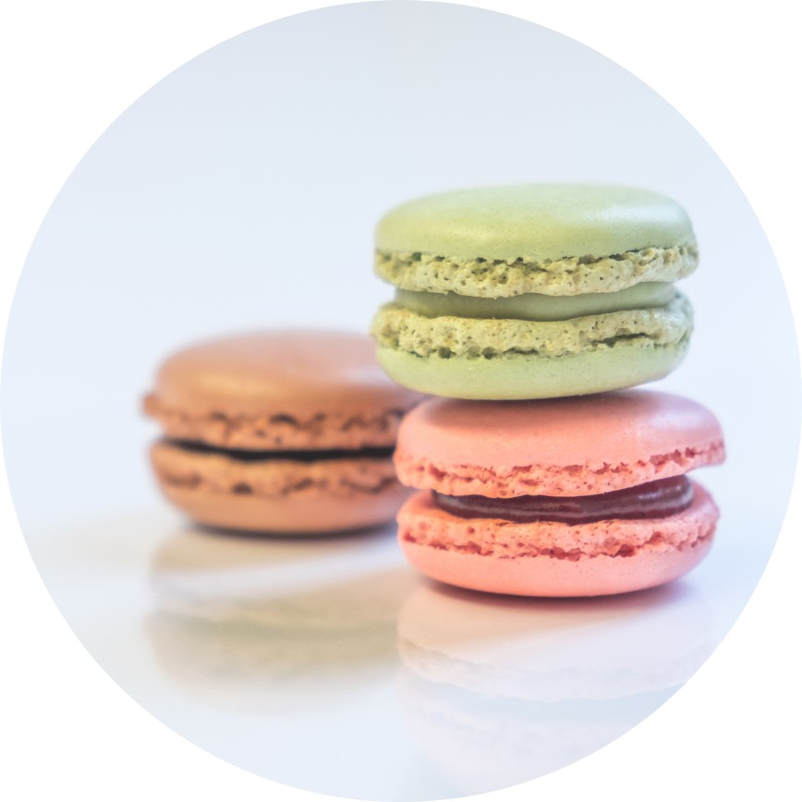
Zomato Interaction Design
Name-KASHISH KAPOOR
Registration no-12108223
Section-KO363

Slide 2

List Of Contents
1.Introduction to Zomato as FOOD-TECH
2.Problem Identified
3.Objective of app
4.Target audience of app
5.Brainstorming
6.Competitive analysis
7.Survey
8.Persona
9.Empathy Mapping
10.Current User Flow
11.Insights
12.Redefine the design brief.

Slide 3
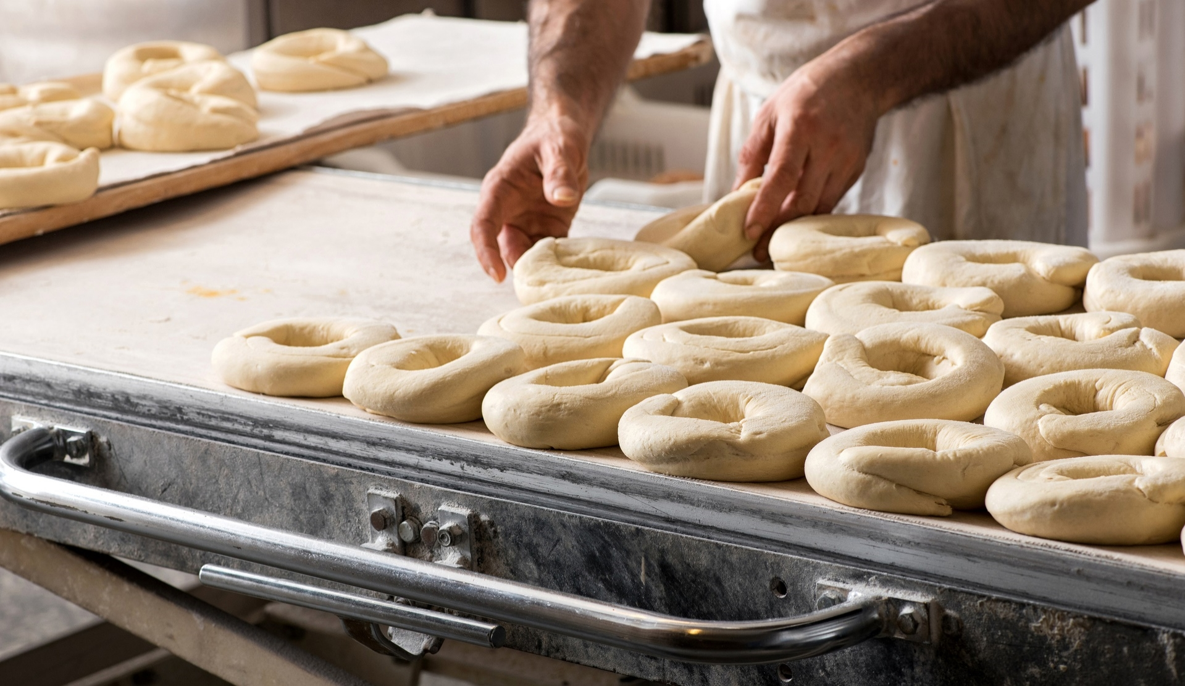
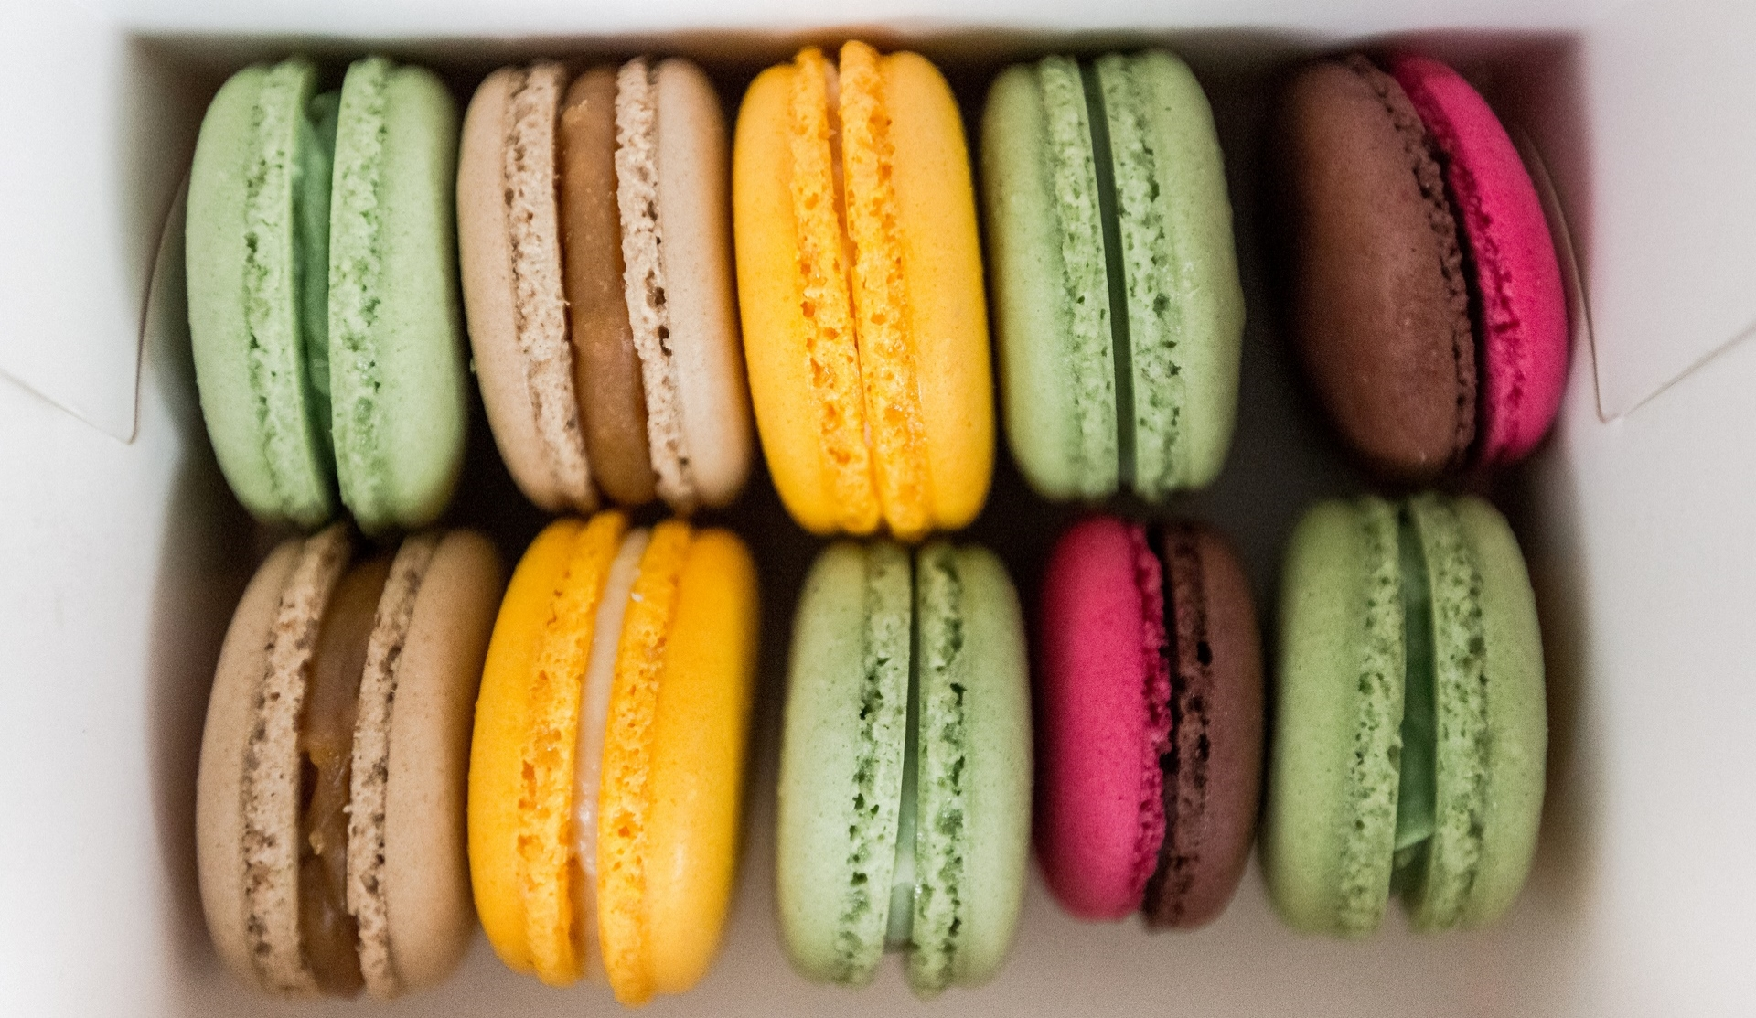
Introduction to Zomato as FOOD-TECH
Zomato is a pioneering food technology application that has revolutionized the way people explore, order and experience food. Founded in 2008, Zomato started as a restraint discovery platform and has since evolved into a comprehensive food ecosystem that connects users with a diverse range of culinary experiences. At its core, Zomato leverages technology to bridge the gap between food enthusiasts and the vibrant world of restaurants, catering to a wide spectrum of user needs and preferences.

Slide 4
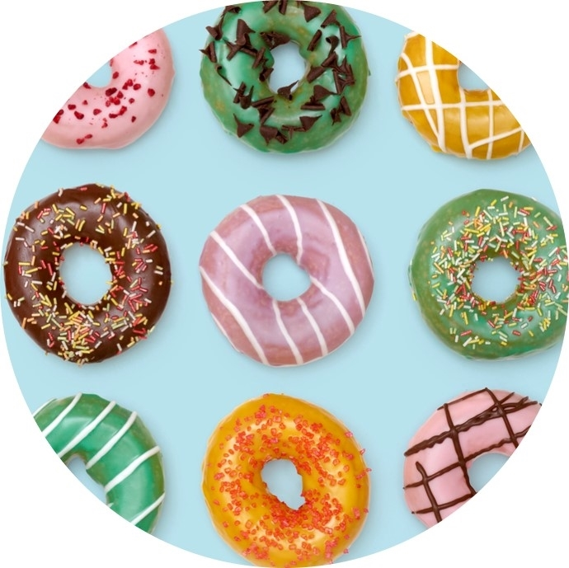
Problem Identified
1.Late Delivery
2.Inaccurate Orders
3. Inconsistent Food Quality
4.App Glitches
5. User Interface Complexity.
6.Payment Options
7. Inaccurate delivery tracking

Slide 5
Objective of the app
The primary objective of the app is to provide seamless platform that connects users with a diverse range of restaurants and food delivery services. The app aims to offer a convenient and user-friendly experience for users to explore, order, and enjoy a variety of cuisines from their favorite local eateries and restaurants. Zomato also seeks to foster a sense of community among food enthusiasts by enabling them to discover new dining options, share their experiences, and make informed choices.

Slide 6
Target Audience
Busy Professionals
College students
Food enthusiasts
Health-conscious individuals
Tech-Savvy Users
Families
Tourists
Socializers
Urban dwellers
.Business professionals

Slide 7
Brainstorming
Local food events
Subscription Plans
Restaurant Virtual Tours
Healthy food options
Ethnic Cuisine exploration
Food allergies and dietary restrictions
Gamified Rewards
Sustainable Packaging
Augmented Reality menu options.

Slide 8
Competitive Analysis
 | Zomato | Swiggy | Food Panda
Revenue(in cr) | 332 | 133 | 162
ILoss(in cr) | 389 | 205 | 45
Daily orders | 45000 | 35000 | 30000
Funding raised | 1317 | 113 | 110

Slide 9
Survey 1.Questionnaire 2. Responses Link-: https://docs.google.com/forms/d/1d5KmoBGMrg8f-NxNbOeO6zbO13UywdLoaPNpscBJEwc/edit

Slide 10
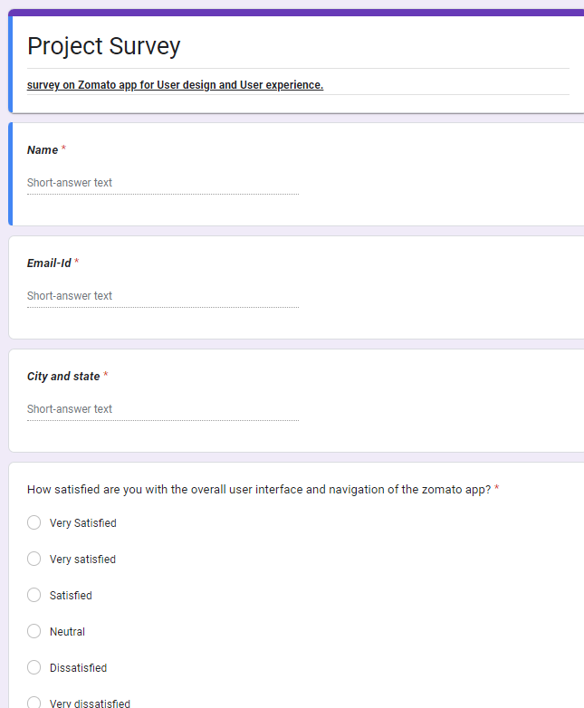

Slide 11
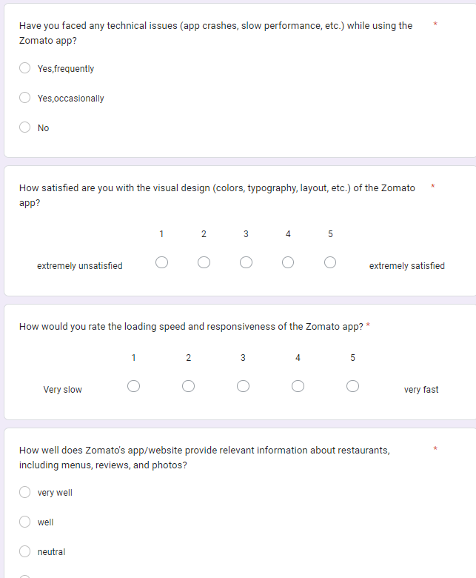

Slide 12
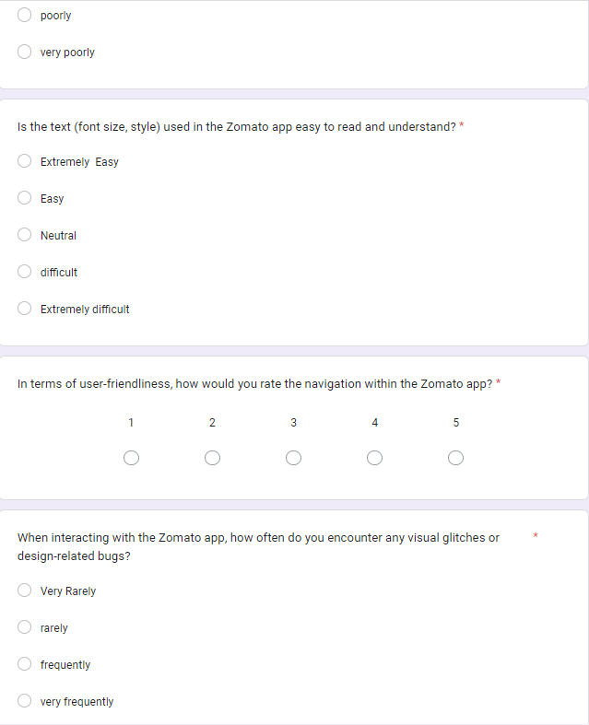

Slide 13
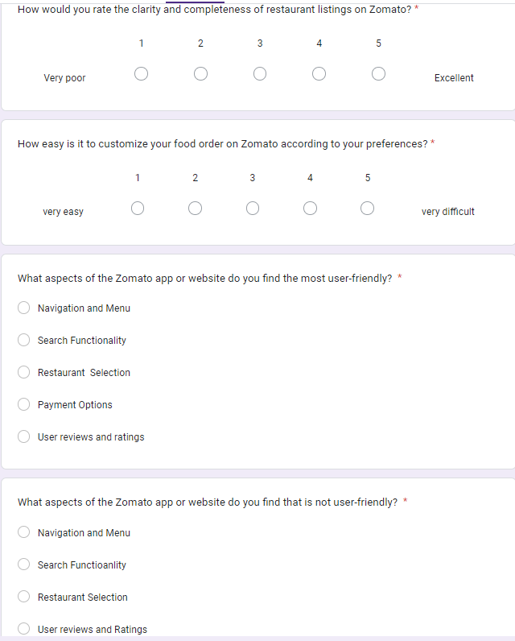

Slide 14
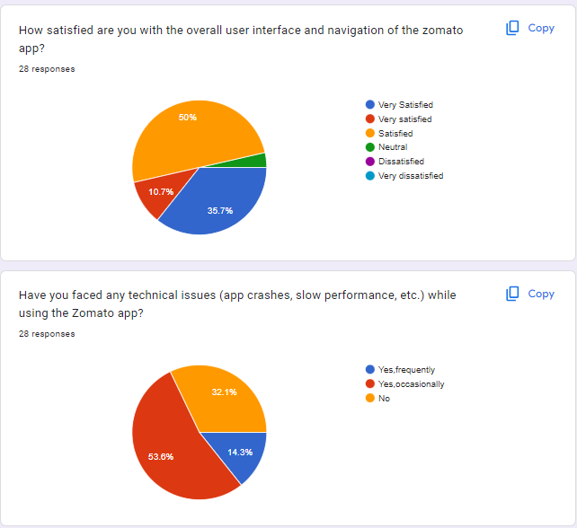

Slide 15
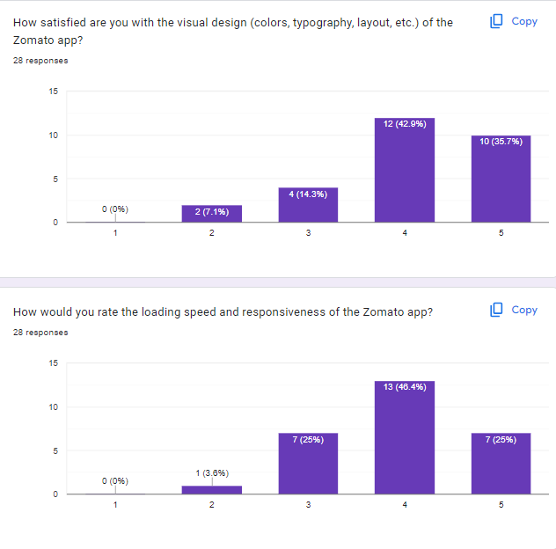

Slide 16
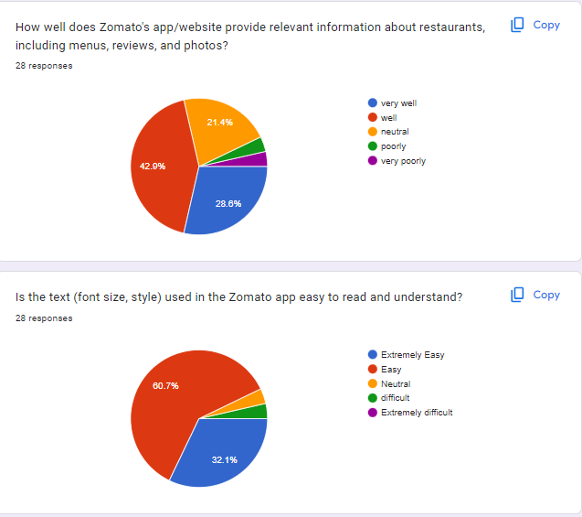

Slide 17
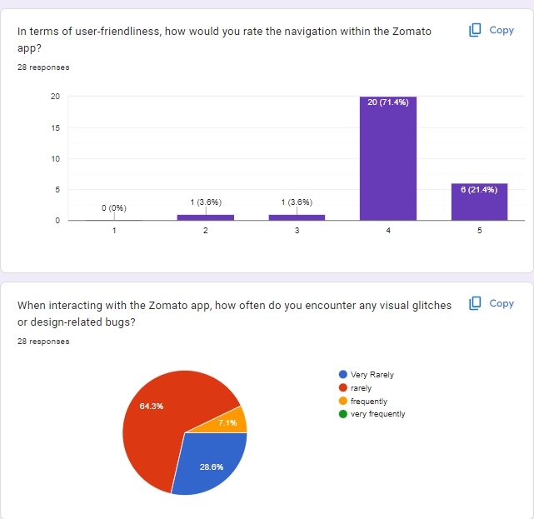

Slide 18
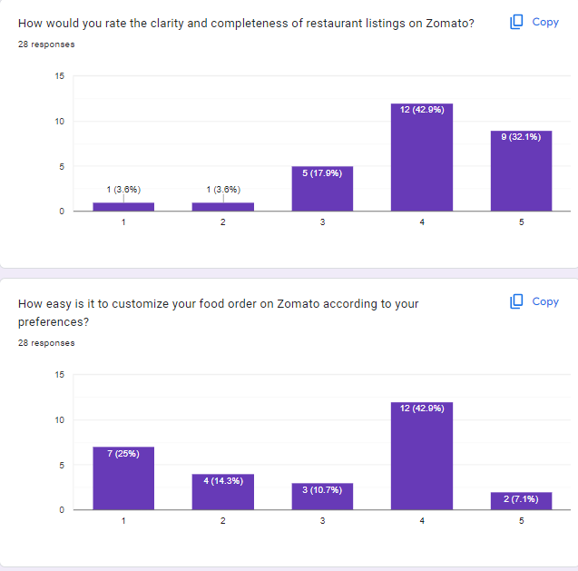

Slide 19
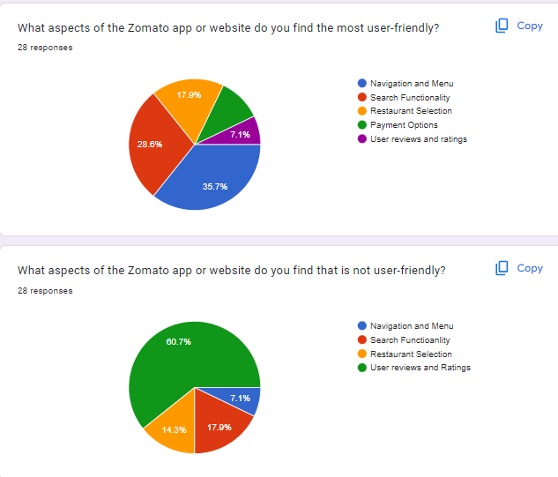

Slide 20
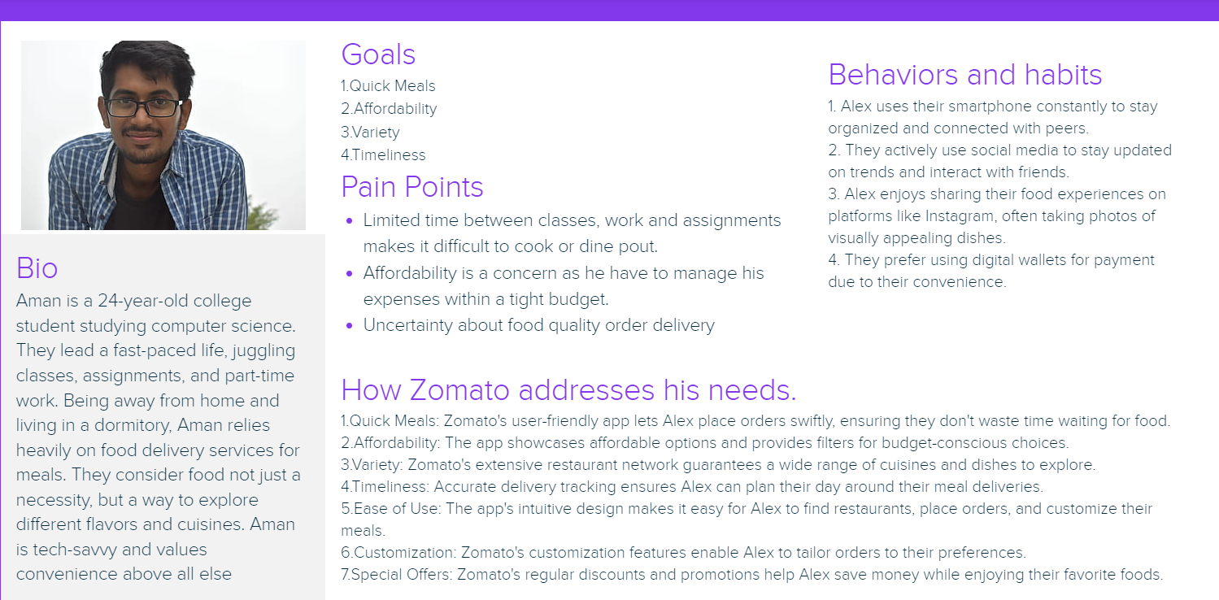
User Persona

Slide 21
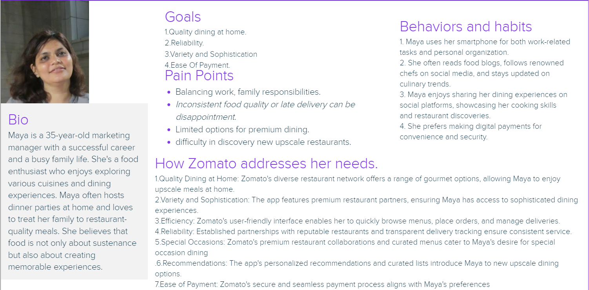
User Persona

Slide 22
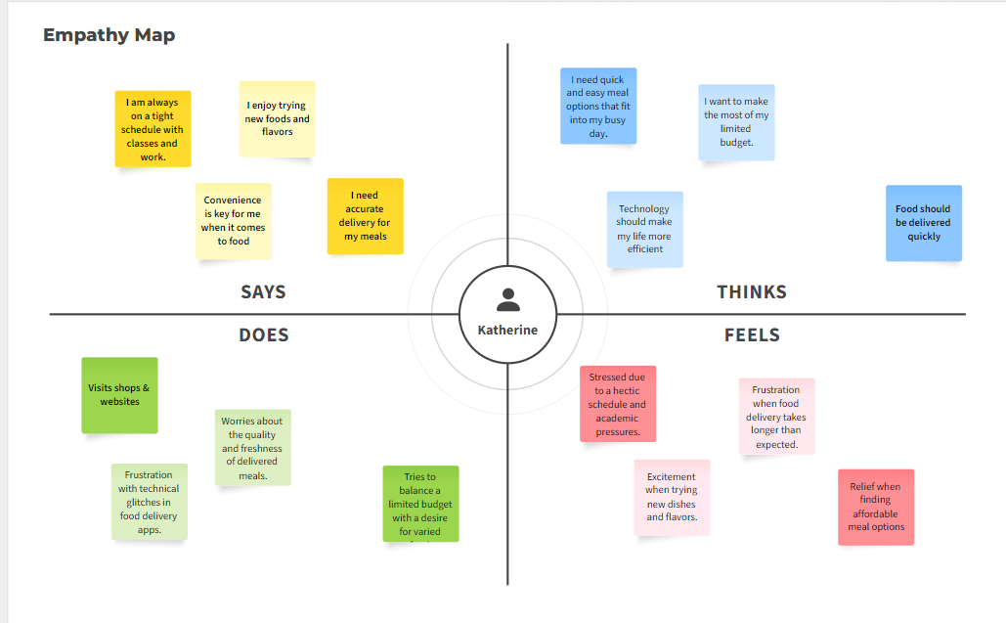
Empathy Map
Aman

Slide 23
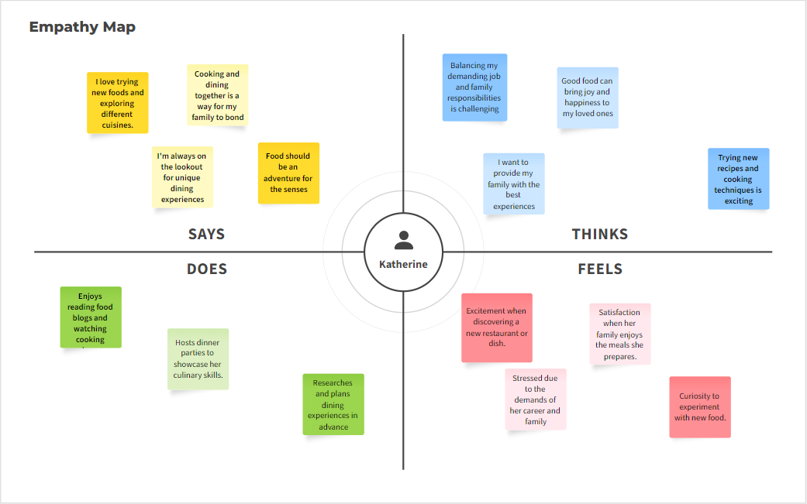
Empathy Map
Maya

Slide 24
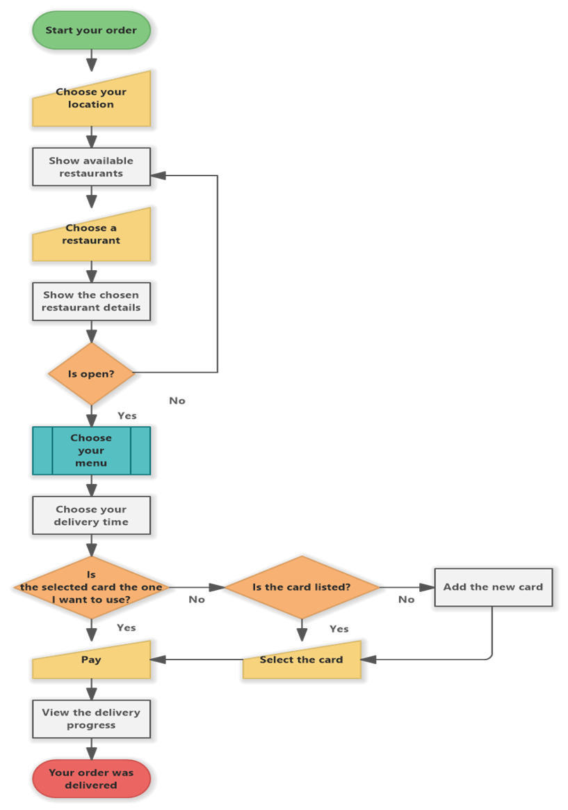
Current User Flow

Slide 25
Insights
Easy Navigation
User generated revies and ratings.
Healthy food options
Comprehensive restaurant information.
Expand restaurant partnership
Fo restrictions
Seasonal Menu
Customer support
Cuisine Trends

Slide 26
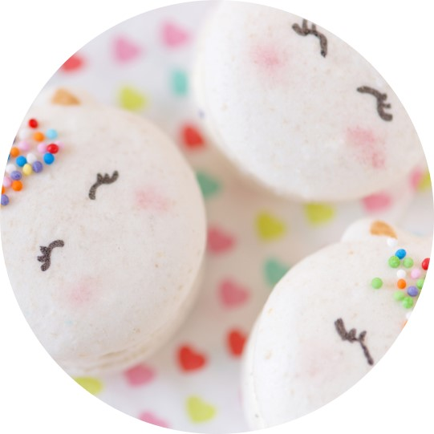
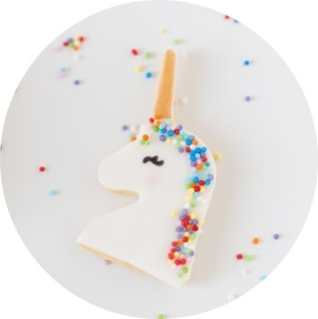
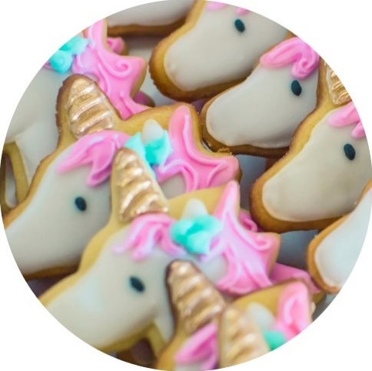
Redefine the design brief
Based on the survey, I prioritize -
Streamline the search process to make it quick and easy to search for a restaurant

Slide 27
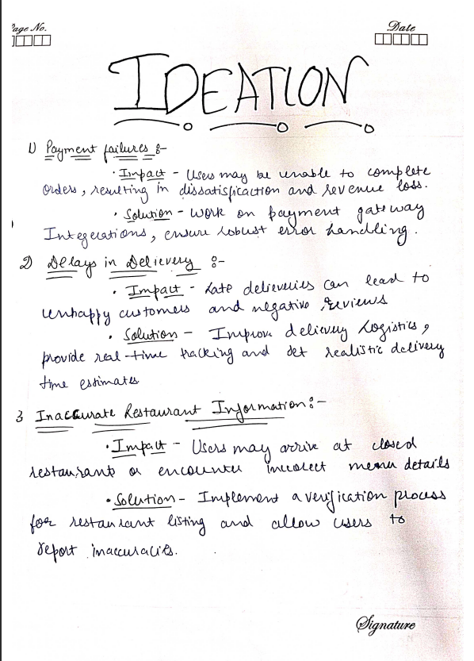
IDEATION

Slide 28
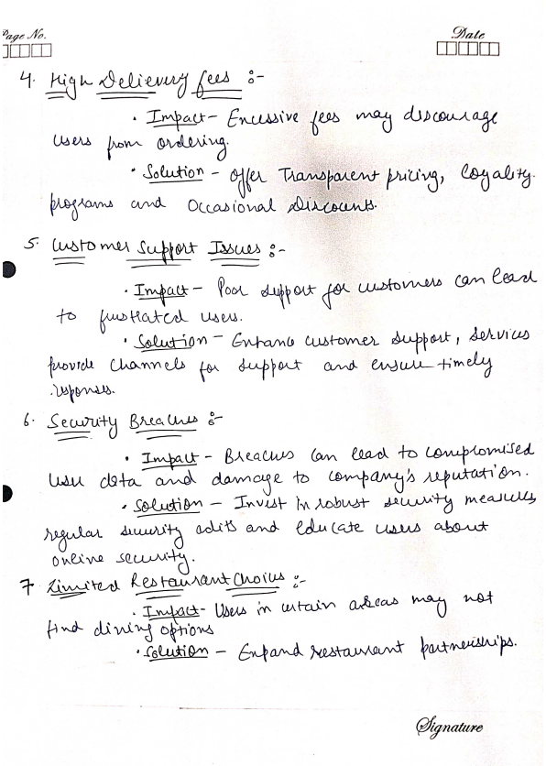
IDEATION

Slide 29
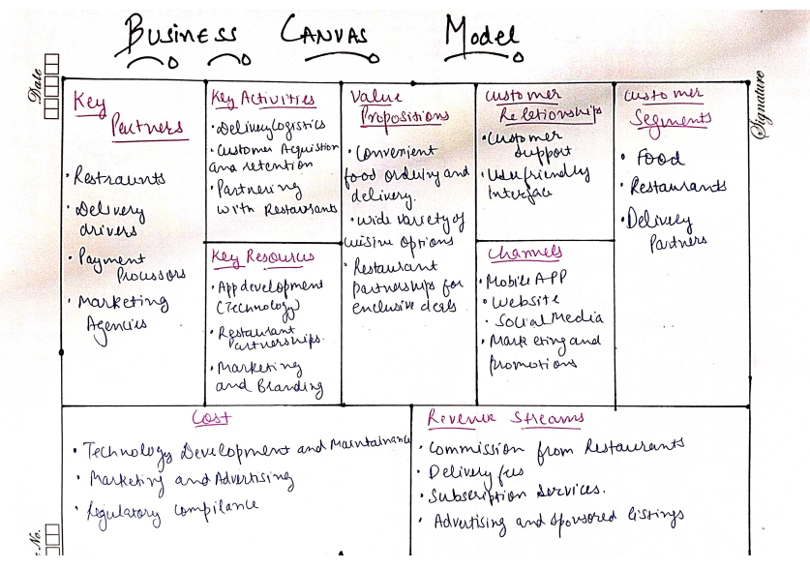
Business Canvas Model

Slide 30
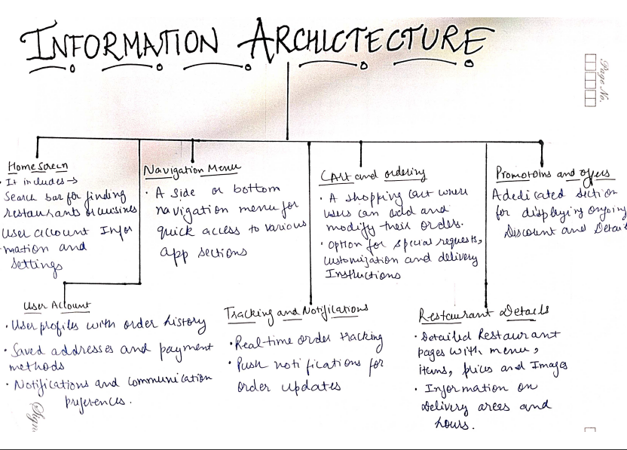
Information Architecture

Slide 31
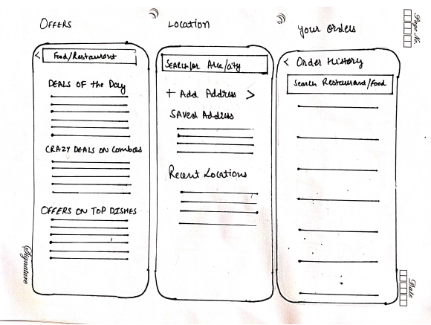
Low–Fidelity wireframes

Slide 32
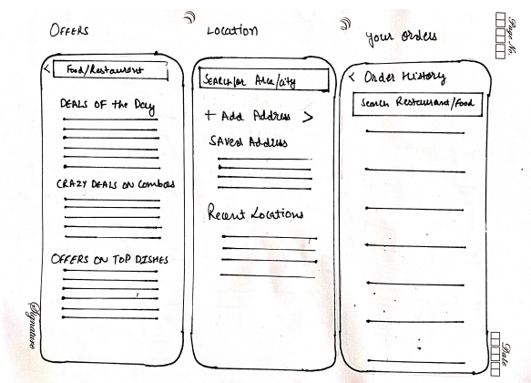
Low–Fidelity wireframes

Slide 33
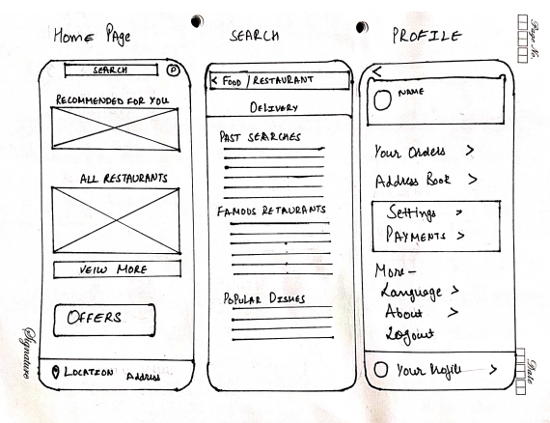
Low–Fidelity wireframes

Slide 34
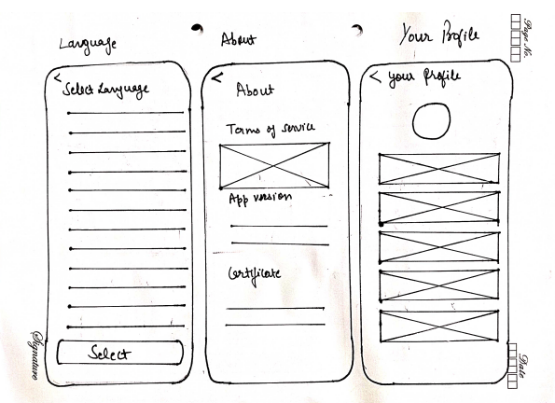
Low–Fidelity wireframes

Slide 35
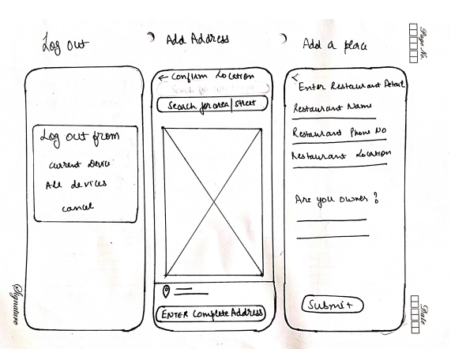
Low–Fidelity wireframes

Slide 36
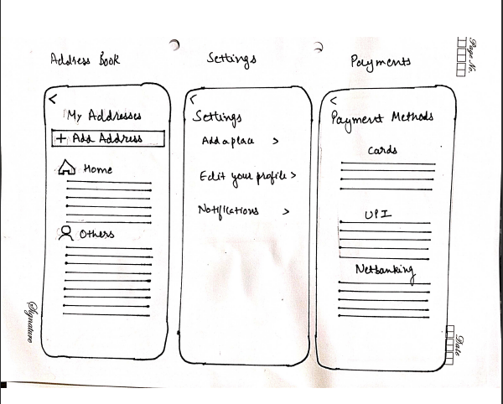
Low–Fidelity wireframes

Slide 37
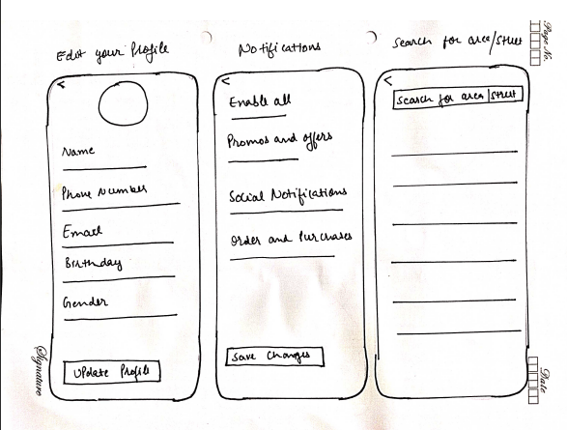
Low–Fidelity wireframes

Slide 38
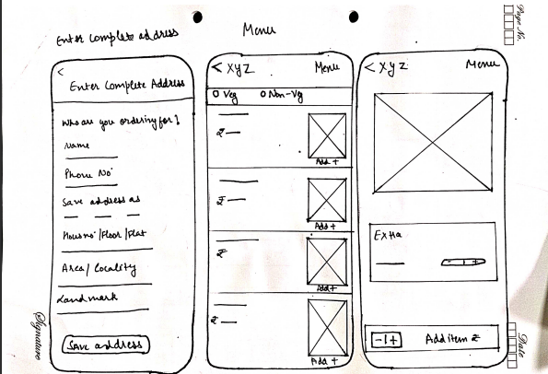
Low–Fidelity wireframes

Slide 39
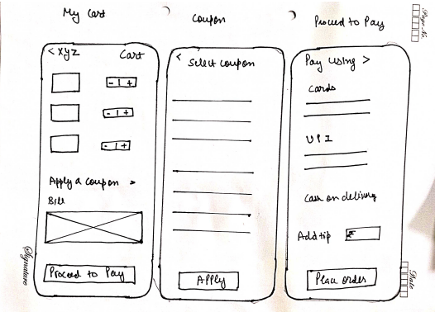
Low–Fidelity wireframes

Slide 40
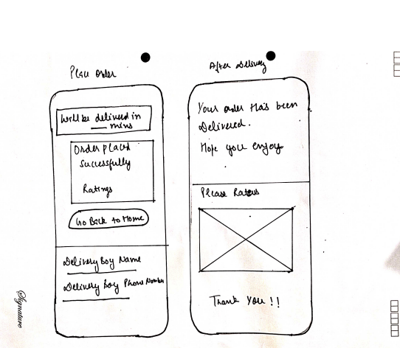
Low–Fidelity wireframes

Slide 41
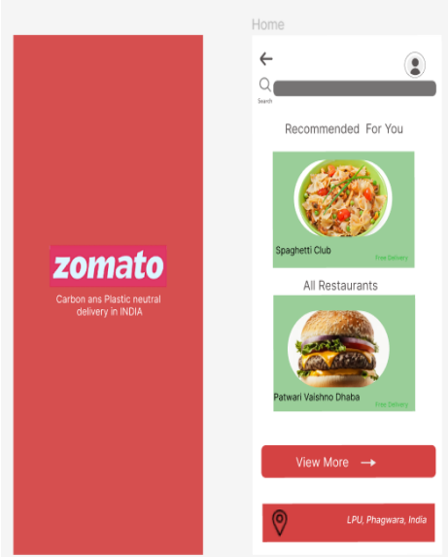
High–Fidelity wireframes

Slide 42
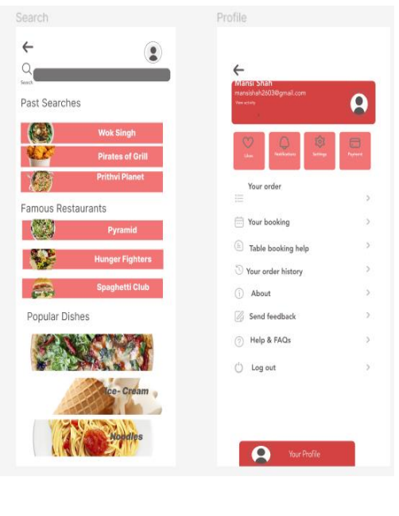
High–Fidelity wireframes

Slide 43
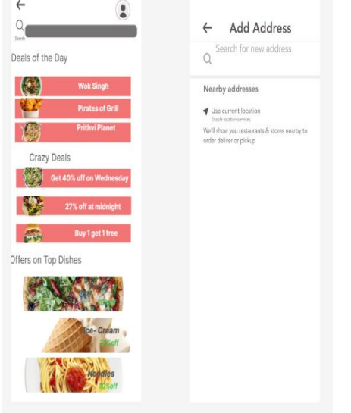
High–Fidelity wireframes

Slide 44
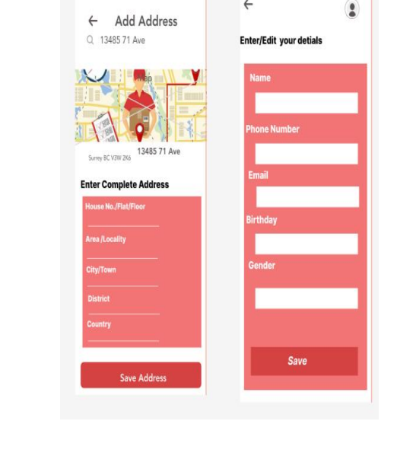
High–Fidelity wireframes

Slide 45
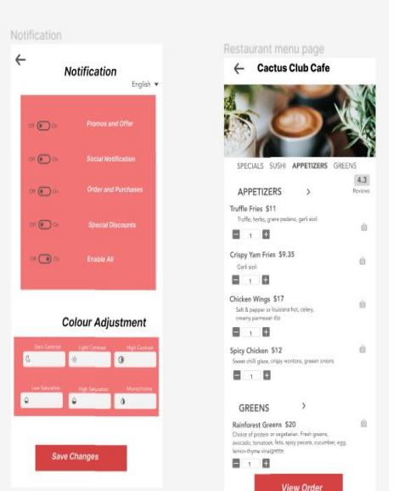
High–Fidelity wireframes

Slide 46
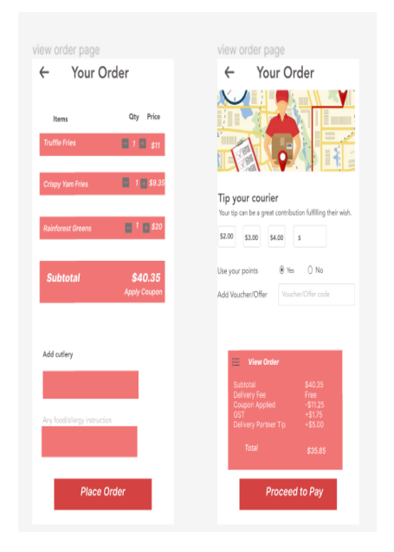
High–Fidelity wireframes

Slide 47
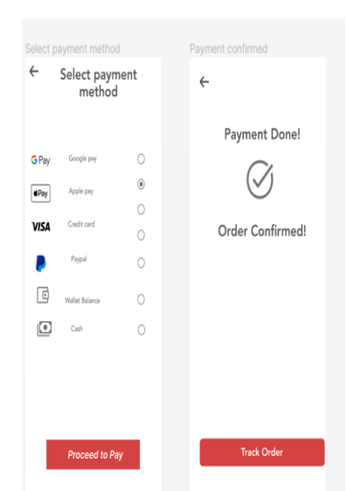
High–Fidelity wireframes

Slide 48
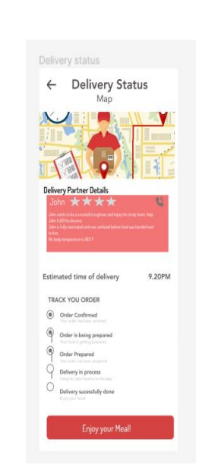
High–Fidelity wireframes

Slide 49

THANK YOU

